Slide 1

ML Project Review
Smart Disease Prediction System with Model Ensemble
Presented by
Mr. CH. Sasi Kanth(24B11CS071)
Mr. L. Krishna Manohar(24B11CS250)
Mr. T. Vijay Kumar(24B11CS429)
Mr. T. Venkatesh(24B11CS443)
Department of Computer Science And Engineering

Slide 2

INTRODUCTION
The Smart Disease Prediction System is a machine learning-based application that predicts disease risk using patient health and lifestyle information.
Smart Analysis: Analyzes important health parameters such as age, blood pressure, glucose, cholesterol, BMI, smoking, physical activity, and medical history.
Machine Learning: Uses trained classification models to identify patterns in patient data and generate disease-risk predictions.
Fast & Simple: Provides quick predictions based on the patient's health information.
Technology Stack:
Language: Python
Libraries: Pandas, Scikit-learn, Pickle
Models: Logistic Regression, Decision Tree, Random Forest
Dataset: 1,500 patient records
Tools: VS Code, Command Prompt / Terminal

Slide 3
PROBLEM STATEMENT
In traditional disease prediction:
Disease risk assessment often requires medical expertise and multiple health parameters.
Patients may find it difficult to understand their disease risk from everyday health information.
Analyzing factors such as age, blood pressure, glucose, cholesterol, BMI, lifestyle, and medical history manually can be time-consuming.
Different health conditions may show similar or overlapping risk factors, making early risk identification challenging.
There is a need for a smart and simple machine learning-based system that can analyze patient data and provide quick disease-risk predictions.

Slide 4
OBJECTIVES OF THE PROJECT
The main objectives of the project are:
To collect and prepare patient health data for disease prediction.
To analyze important health, lifestyle, and medical history features.
To train and evaluate multiple Machine Learning classification models.
To predict disease risk based on the patient's health information.
To develop a simple and fast prediction system that provides understandable results.
To support early identification of potential disease risk using Machine Learning.

Slide 5
SCOPE OF THE PROJECT
The scope defines where the system is applicable and what it offers.
Disease Risk Prediction: Uses patient health and lifestyle information to predict disease risk.
Health Awareness: Provides a quick indication of possible disease risk based on the available data.
Machine Learning Application: Demonstrates the complete ML process including data preprocessing, model training, and prediction.
Extendable System: Can be enhanced with larger datasets, additional diseases, advanced ML models, and a web/mobile application.

Slide 6
MODULE DESCRIPTION
The system consists of the following modules:
Data Preprocessing Module: Cleans and prepares the patient dataset for machine learning.
Model Training Module: Trains Logistic Regression, Decision Tree, and Random Forest models using the processed data.
Prediction Module: Takes patient health information as input and predicts the disease risk.
Model Evaluation Module: Evaluates and compares the trained models using performance metrics such as Accuracy, Precision, Recall, and F1-Score.
Result Module: Displays the final disease-risk prediction in a simple and understandable format.

Slide 7
DATASET DESIGN
Dataset: disease_data.csv (1,500 records, 12 columns)
Target: target (0 = No Risk, 1 = Risk)
Numeric Columns:
Age
Blood Pressure
Heart Rate
Glucose
Cholesterol
BMI
Category Columns:
Gender
Smoking
Physical Activity
Yes / No Columns:
Family History
Heart Disease

Slide 8
DATA PREPROCESSING
Steps performed during data preprocessing:
Load the Dataset: Load the disease_data.csv containing 1,500 patient records and 12 attributes.
Check Data Quality: Check the dataset for missing values and duplicate records.
Handle Missing Values: Identify and handle missing values in numerical and categorical features appropriately.
Encode Categorical Data: Convert categorical features such as Gender, Smoking, and Physical Activity into numerical form.
Feature Preparation: Separate the input features from the target variable for machine learning.
Feature Scaling: Scale numerical features where required to bring them to a common range.
Prepare for Training: The processed dataset is prepared for training and testing the machine learning models.

Slide 9
FEATURE SELECTION
The system uses the available health, lifestyle, and medical-history attributes to predict the target outcome.
Age
Gender
Blood Pressure
Heart Rate
Glucose
Cholesterol
6. BMI
7. Smoking
8. Physical Activity
9. Family History
10. Heart Disease
Weight is also asked (with Height) only to calculate and display BMI.

Slide 10
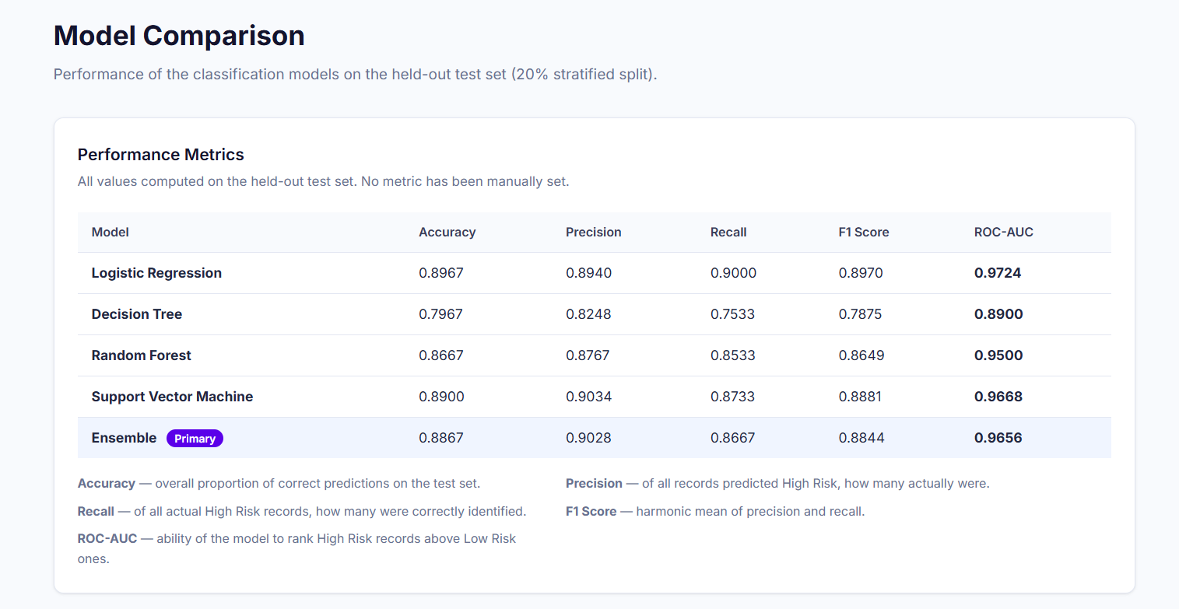
MODEL TRAINING
The dataset is divided into 80% training and 20% testing using a stratified split, and the data is scaled before training.
Accuracy, Precision, Recall, F1-Score, and ROC-AUC are used to evaluate the classification models.
Confusion Matrix and Classification Report are generated for model evaluation.
The Ensemble model combines the predictions of multiple models to produce the final prediction.

Slide 11
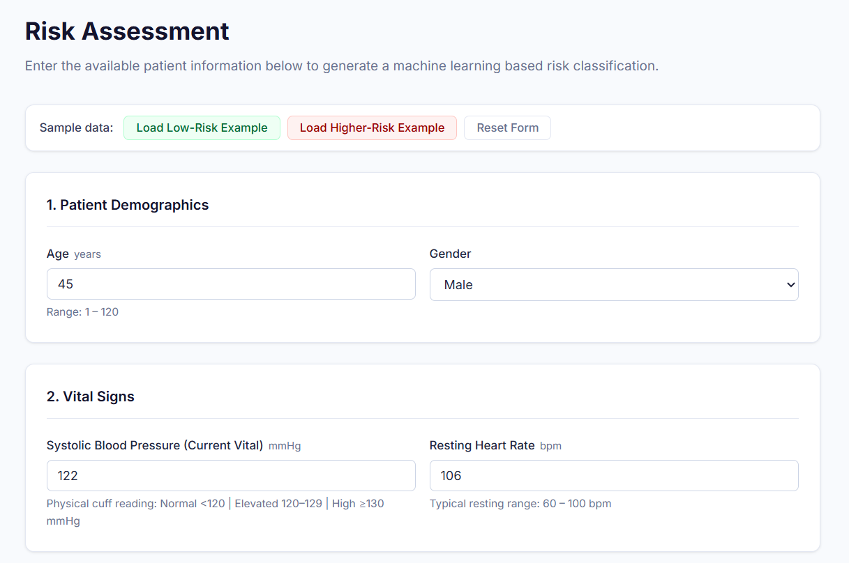
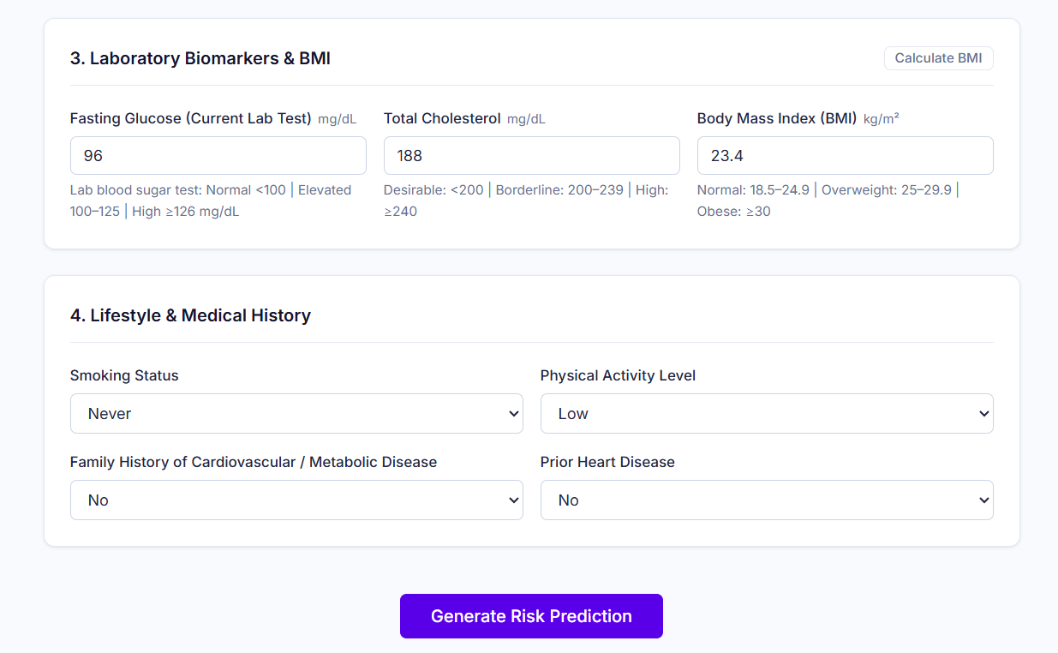
CONSOLE INPUT
predict.py collects patient health information through simple questions. Age, gender, blood pressure, heart rate, glucose, cholesterol, BMI, smoking, physical activity, family history, and heart disease details are processed and passed to the trained models to generate the disease-risk prediction.

Slide 12
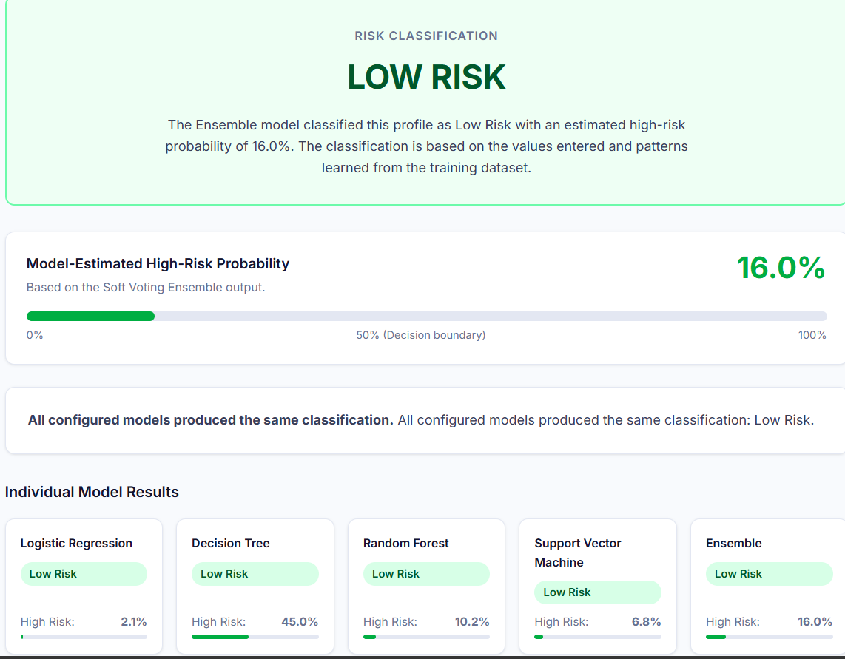
CONSOLE OUTPUT
The final risk % is generated from the combined model predictions. Risk of 50% or more is classified as HIGH RISK, otherwise LOW RISK, with a matching risk summary.

Slide 13
CONCLUSION
The Smart Disease Prediction System demonstrates a complete Machine Learning pipeline for predicting disease risk from patient health and lifestyle data.
The dataset was processed and prepared for machine learning prediction.
Multiple ML models including Logistic Regression, Decision Tree, and Random Forest were trained and evaluated.
The system analyzes important health, lifestyle, and medical-history parameters to generate a disease-risk prediction.
The system provides a simple and quick prediction based on the given patient information.
The project demonstrates how Machine Learning can be applied to healthcare data for preliminary disease-risk prediction.
The system can be further improved using larger datasets, additional disease parameters, and advanced ML models.

Slide 14
FUTURE ENHANCEMENTS
1. Real Clinical Data: Train on a real-world dataset to test true accuracy.
2. Cross-Validation and Tuning: Check for overfitting and tune model settings.
3. More Models: Try XGBoost, SVM or neural networks.
4. Explainability: Show which factors raised the user's risk.
5. User Interface: Build a web or mobile app (Streamlit / Flask) instead of the console.

Slide 15
THANK YOU

